Slide 1
1. Business Problem
Identify where the business is growing profitably and where value is being lost.
Focus: category performance, discounting, markets, segments and shipping.
Working copy: 51,290 transaction rows and 24 source columns.
TRANSACTIONS
PRODUCTS
DISCOUNTS
MARKETS
PROFIT
Business lens: Revenue → Margin → Action

Slide 2
2. Data & Methodology
Public source plan: Global Superstore dataset on Kaggle.
Python: Pandas + NumPy for cleaning, feature engineering and aggregation.
Created Delivery Days, Profit Margin, Discount Band, Profit Status, Year/Month/Quarter and an outlier flag.
Postal Code was excluded from analysis because it is incomplete and not required for the management questions.
01
CLEAN
02
CALCULATE
03
COMPARE
04
EXPLAIN
05
RECOMMEND

Slide 3
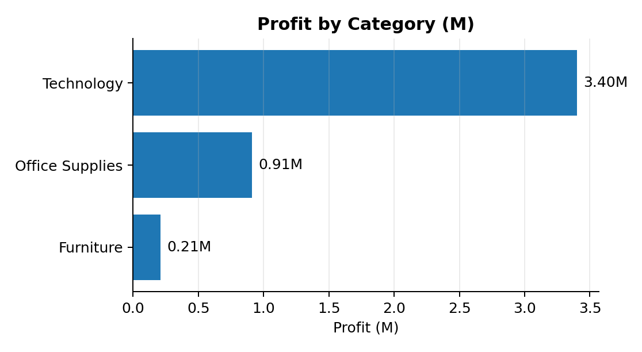
3. Key Findings
Sales: 46.9M; Profit: 4.5M; overall margin: 9.7%.
Technology is the largest sales and profit category.
Furniture generates about 10.8M sales but only about 1.9% margin.
30%+ discounts are loss-making in the working copy.
46.9M
Sales
4.5M
Profit
9.7%
Margin
17.5%
Loss Rows

Slide 4
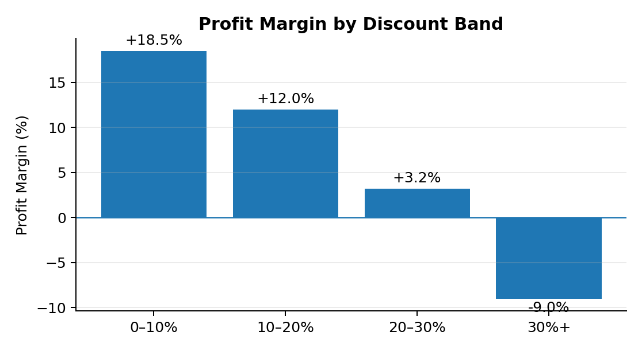
4. Deep-Dive Insight
Discounting and profitability move in opposite directions in the working copy.
0–10% discount margin is about 18.5%; 20–30% is about 3.2%; 30%+ is about -9.0%.
This indicates a clear commercial-control opportunity.
The data is observational, so the result should be validated with controlled discount tests.
DEEPER DISCOUNT → HIGHER PROFIT RISK

Slide 5
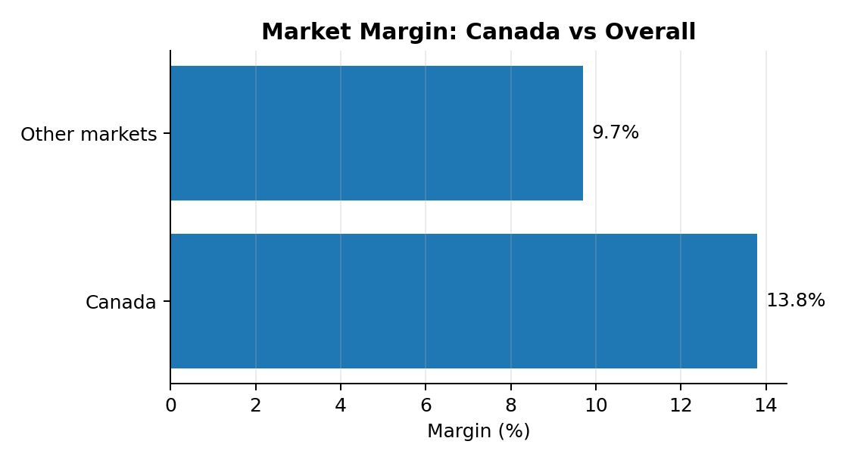
5. Recommendations
1. Require approval for 30%+ discounts and test lower discount thresholds.
2. Run a Furniture margin-recovery program covering pricing, assortment and discount discipline.
3. Study Canada’s high-margin operating pattern and test similar tactics in selected markets.
Opportunity Matrix
CANADA
High margin / smaller base
TECHNOLOGY
High profit / scale
FURNITURE
High sales / low margin

Slide 6
6. Expected Business Impact
Lower loss-order rate and higher profit margin.
Higher Furniture profitability without relying only on revenue growth.
More profitable expansion in smaller high-margin markets.
Measure: Profit Margin, Loss Order %, Sales, Profit, Discount Rate and market-level incremental profit.
1
CONTROL DEEP DISCOUNTS
HIGH IMPACT
Sales + Finance
2
RECOVER FURNITURE MARGIN
HIGH IMPACT
Category + Pricing
3
TEST HIGH-MARGIN PLAYBOOKS
MEDIUM IMPACT
Regional Sales + Strategy

Slide 7
7. Limitations & Next Steps
Descriptive analysis does not establish causality.
No CAC, inventory cost or competitor pricing is available.
Postal Code is incomplete and excluded.
Next: replace the practice copy with the official public file, publish the live Looker Studio dashboard and run controlled discount pilots.
TEST
MEASURE
LEARN
SCALE
Success metrics: Profit Margin • Loss Order % • Sales • Profit • Discount Rate • Incremental Market Profit

